Slide 1
Model for Prediction of House Prices
M.S.JISHNU

Slide 2
Aim
To create a web-based facility for customers to enter address of a house and obtain graph showing trend of price of house since last sold, extrapolated to current date.

Slide 3
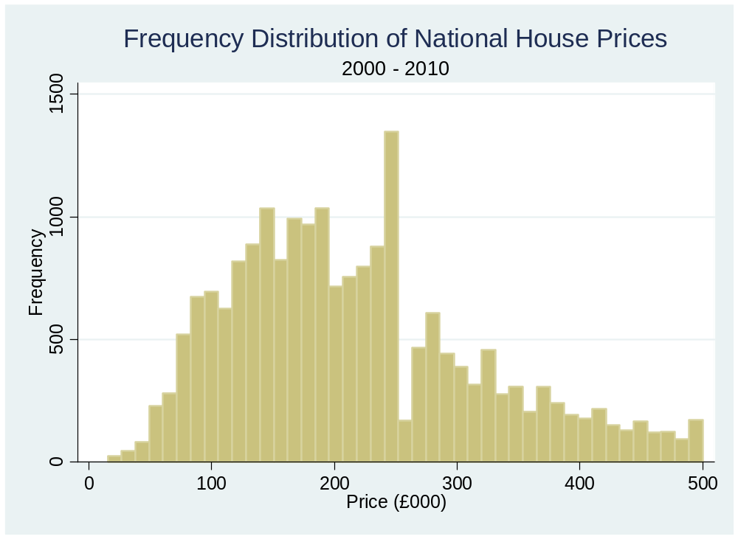

Slide 4
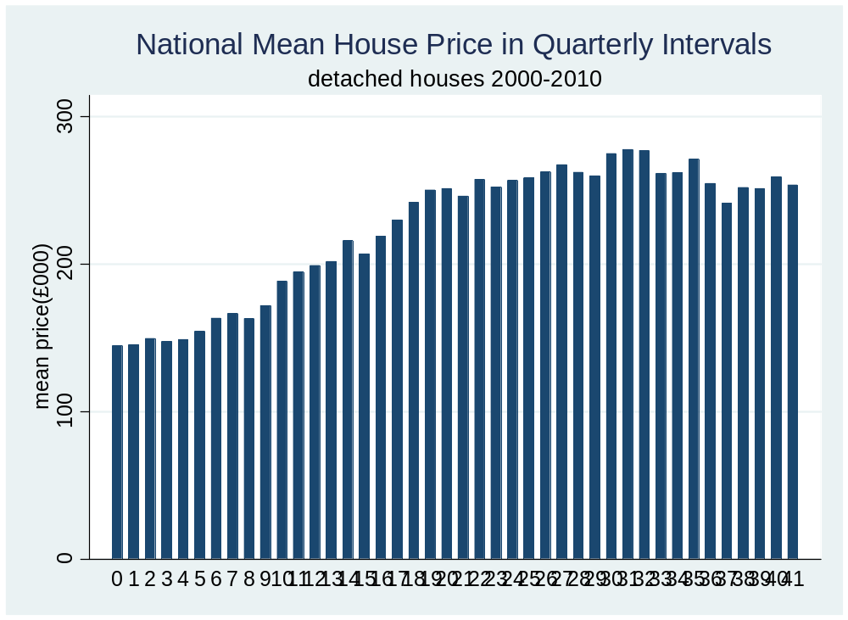

Slide 5
Initial plan was to model prices of houses in the vicinity of the target house in real time and hence estimate current price.
The next slide shows the sale prices of 18 nearest houses to a target house last sold in August 2006 for £485k.

Slide 6
18 nearest houses to Target House £485,000 18/08/2006 in TN16 1RP
Price (£000) | date | miles | Post code TN16 |  | Price (£000) | date | miles | Post code TN16
500 | 15/08/2006 | 0.95 | 1SD |  | 415 | 09/03/2004 | 1.09 | 1PZ
630 | 29/05/2007 | 0.95 | 1SD |  | 307 | 30/09/2003 | 1.09 | 1PZ
350 | 28/02/2005 | 0.95 | 1SD |  | 400 | 30/06/2006 | 1.09 | 1TU
385 | 01/05/2003 | 0.95 | 1SD |  | 247.5 | 04/07/2007 | 1.22 | 1TF
365 | 23/10/2003 | 0.95 | 1SD |  | 412 | 17/11/2006 | 1.26 | 1RG
202 | 28/05/2004 | 0.99 | 1RE |  | 295 | 10/11/2003 | 1.26 | 1RG
465 | 03/06/2004 | 0.99 | 1RE |  | 455 | 31/08/2005 | 1.44 | 1AJ
350 | 07/07/2004 | 1.04 | 1TS |  | 1020 | 25/04/2003 | 1.51 | 1SE
330 | 30/03/2007 | 1.04 | 1TS |  | 430 | 29/10/2003 | 1.56 | 1SA

Slide 7
Linear regression was used to give a prediction for current date using as predictors date and distance from target house.
Predictions compared with known recent sale prices
Problems:
1: To get 50 houses sold in the relevant time period could require including houses a great distance away.
2: Predictions were out by as much as £100k.
3: Too much variability.

Slide 8
Great Price Crash of 2008-2009
From autumn 2008 the great price crash began. This ruled out linear models.
New strategy required.
Decided to model the national price trend and apply this to the last known sale price of a target house.

Slide 9
The Stata ado ‘uvrs’ (with user specified knots) was used to model the national price curve.
The parameter estimates were saved.
Later, to respond in real time to a query about a particular house, ‘splinegen’ was used to generate the spline curve of mean prices for the required time span to current date.
This was applied to target house.

Slide 10
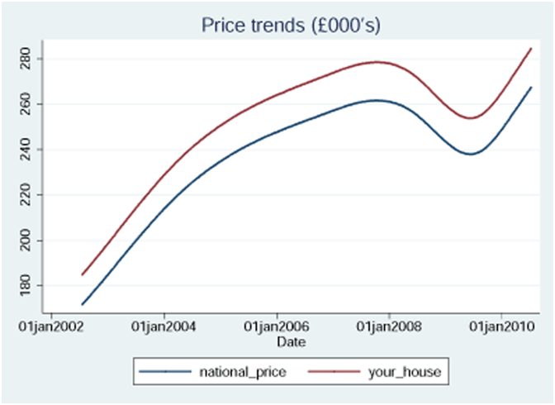

Slide 11
1. Use of coded date
Dates from Land Registry, in Excel, are in days from 01 Jan1900
In Stata, a %td date value is in days from 01Jan1960
Hence conversion of current date code from Stata to Excel format is by the following syntax:
replace date = date(c(current_date),"DMY") + 60*365 + 16
creturn: c(current_date)
* This returns the current date

Slide 12
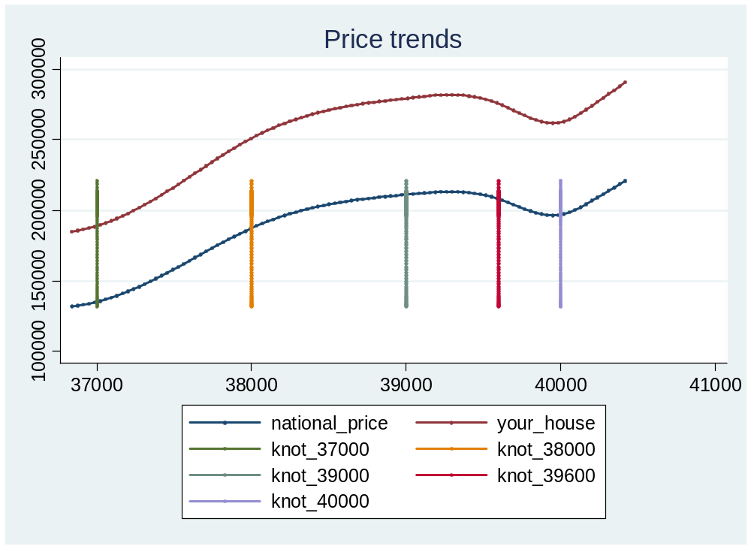
2. Choice of user knots for splines (days since 1900)
uvrs regress priceln date, knots(37000 38000 39000 39600 40000) noorthog

Slide 13
3. Saving and retrieving the knots
uvrs regress priceln date, knots(37000 38000 39000 39600 40000)
file open myfile using makeglobals.do, write replace
file write myfile "global knots `e(knots)'" _n
file write myfile "global bknots `e(bknots)'" _n
file close myfile
This creates a do-file for later use containing commands that create global macros containing the knot values.
This next syntax recreates the globals with required values:
do makeglobals
splinegen date $knots, bknots($bknots)
i.e. splinegen date 37000 38000 39000 39600 40000, bknots(36529 40200)

Slide 14
3. Saving and retrieving the parameter estimates
estimates save "uvrs3"
This creates a binary file for later use containing coefficients etc
This next syntax retrieves the values:
splinegen date $knots, bknots($bknots)
estimates use "uvrs3"
predict yhatln

Slide 15
4. Use of log scale to deal with skewed price distribution
gen lndelta = 150000
gen priceln = ln((price + lndelta)/100)
Inverse transform applied before plotting:
gen national_price = 100*exp(yhatln)-lndelta
Has effect of scaling up price rises of more expensive houses - similar to applying a % increase.

Slide 16
5. Estimation of prediction intervals
95% confidence intervals based on estimated standard errors from the model.
These were large: typically ±£60,000

Slide 17
6. The 2008/2009 slump in house prices
This caused considerable difficulties for the project since the picture was continually changing. The modelling struggled to keep up with the evolving situation which resulted in the project being abandoned.

Slide 18
Limitations
Beyond the range of data only a linear spline is used. This may not be ideal for prediction
We had insufficient information to account for the price of a house – hence too much unexplained variability.
The trial and error process for selection of knots is not appropriate – automatic process required,

Slide 19
Acknowledgements
Dan Winchester of Labworks who funded the work
Patrick Royston, MRC Clinical Trials Unit, London, who provided modified versions of uvrs and splinegen
Kristin MacDonald of StataCorp who helped with globals

